Slide 1
Battle of Neighbourhoods
Location recommendation for a new Indian Restaurant in NYC
Presentation by
Ishan Iyer

Slide 2
Contents
Introduction
Data
Methodology
Result Analysis
Conclusion

Slide 3
Introduction

Slide 4
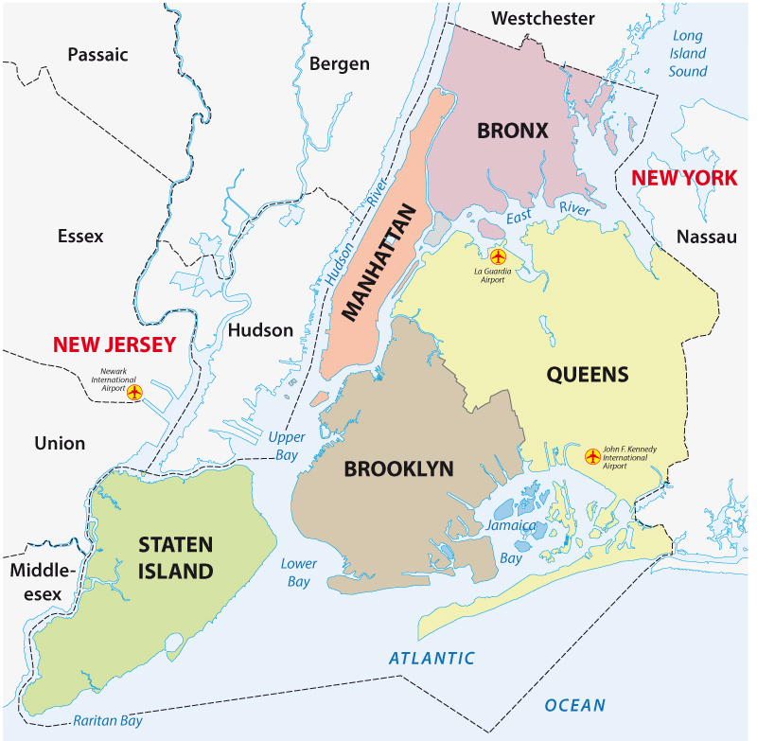
Intro to the business problem
New York City is famous for its diverse and robust food culture, influenced heavily by the city’s large immigrant population. It's basically a big brewing pot with Jewish, Italian, Asian, Middle Eastern etc. restaurants dotted all across the city.
Chef QWERTY wants to be a part of this ever growing industry and help this culture expand further by opening an Indian dine-in restaurant in NYC. His only problem as of now is he doesn’t know which location to pick for his first restaurant, and location is one of the most important parts of any establishment.
He enlists his friend XYZ, who is a data scientist, to help him find the perfect location using data cues. XYZ is happy to help and tells Chef QWERTY that he will get back to him in 2-3 days after crafting a model that will suggest the target neighbourhood.

Slide 5
Factors to consider
New York City population
New York City demographics
Distance from Farmers/Wholesale markets
Entertainment venues nearby that attract crowds
Competitors
Segmentation of borough
Amount of saturation wrt Indian Restaurants in each neighbourhood.

Slide 6
Data

Slide 7
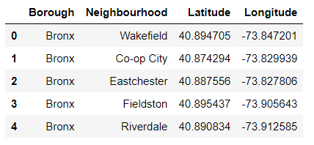
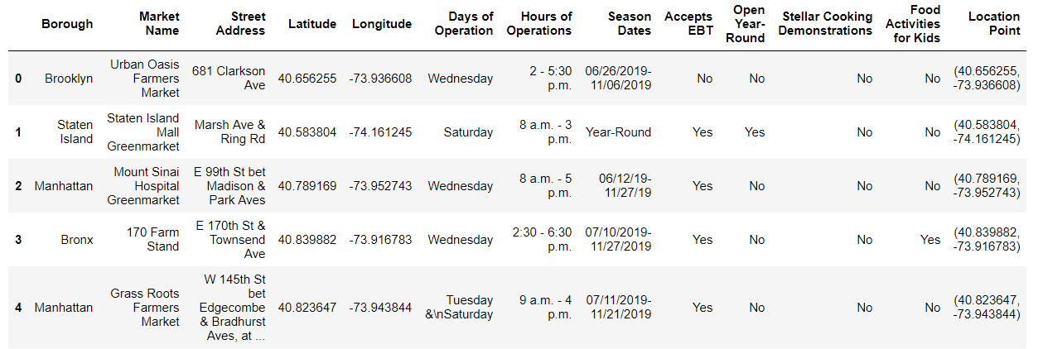
Neighbourhood and Farmers Market geo data
The neighbourhood dataset consist of each neighbourhood and it’s geo coordinates segregated borough wise.
The farmers market dataset consists of every farmers market in NYC and it’s exact location, operation hours, operating days etc.

Slide 8
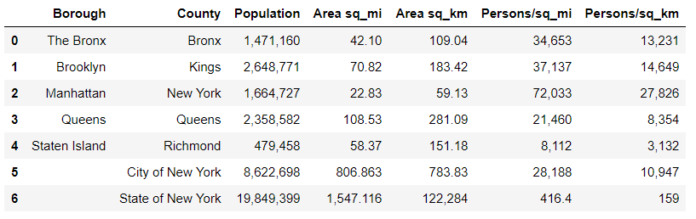
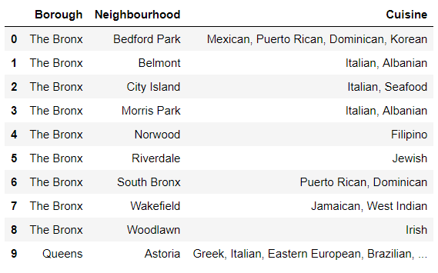
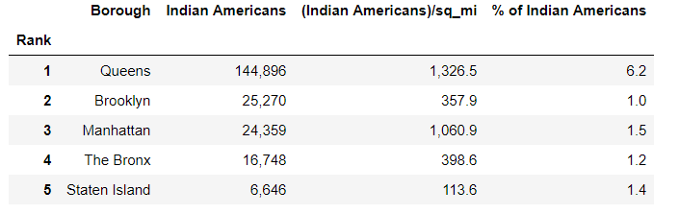
Population, Demographics and Cuisine data
These datasets consist of population distributions, economic distributions, types of cuisines and restaurants, and other demographic data. All data was scraped using BeautifulSoup.

Slide 9
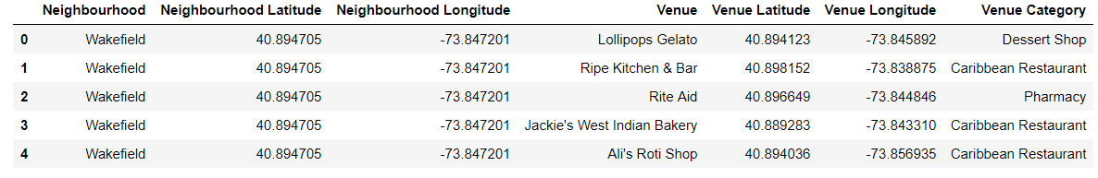
Foursquare API data
The NYC geo coordinates will used by the Foursquare API to provide information on venues and types of establishments in each neighbourhood. This has sections for venue type, venue location etc.

Slide 10
Methodology

Slide 11
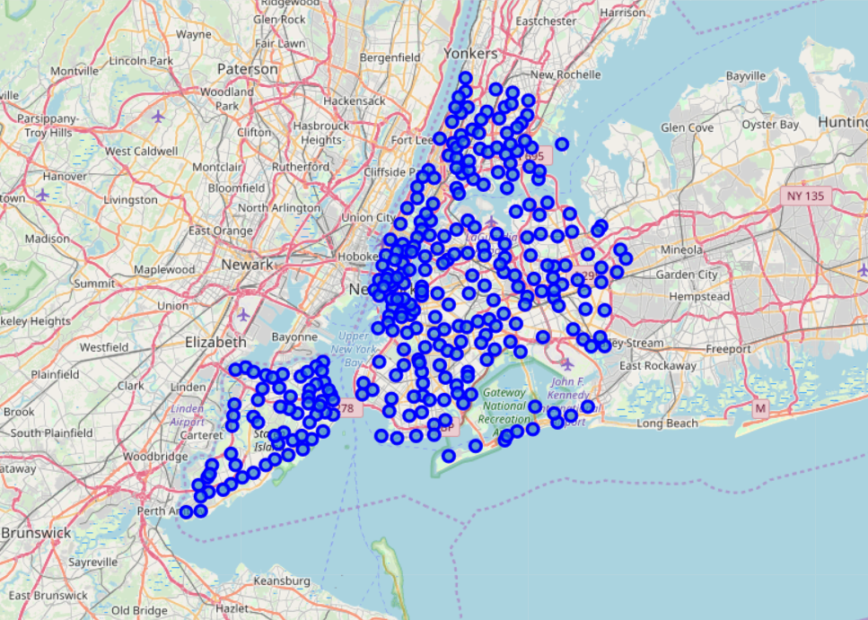
Exploratory Data Analysis
New York City has a total of 5 Boroughs and 306 Neighbourhoods. This project will make a few assumptions basis the exploratory data analysis, which will help us narrow down on a Borough.
Clustering and classification techniques will then be applied on the chosen Borough.
First, the NYC neighbourhood geo dictionaries are transformed into python data frames. Geopy and Folium libraries are used to superimpose coordinate markers onto a map.

Slide 12
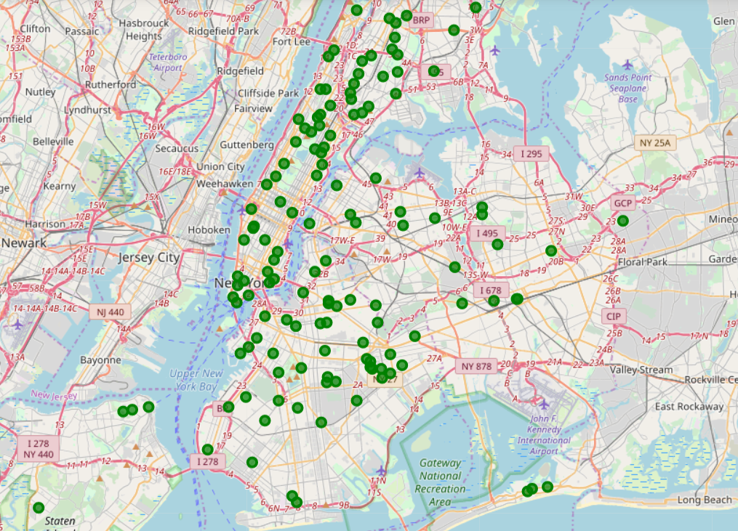
Exploratory Data Analysis
Similarly, NYC farmers market data is superimposed onto a map using Geopy and Folium.
NYC has 139 farmers markets, with the highest number being in Brooklyn and Manhattan.
On analysing the population and demographic data, we learn the following :
Manhattan is the smallest and most densely populated borough, and has a high number of Indians/sq.mile, only losing out to Queens.
Queens is geographically the largest borough with the largest number of Indian-Americans overall.
Brooklyn is the most populated borough.

Slide 13
Exploratory Data Analysis
Most preferred cuisines (in order of preference):
Brooklyn – Italian, Mexican, Puerto Rican
Manhattan – Italian, American, Indian
Queens – Indian, Irish, Pakistani, Mexican
Bronx – Italian, Puerto Rican, Albanian
Basis this, a well-informed choice would be to pick Queens due to the preference and % of Indian-Americans.
Even though Manhattan has similar preferences, it is a very saturated market with a lot of footfall. It is normally harder to break into such markets, and factors such as cost of inventory and property are higher as well.
Continuing, the Foursquare API data containing venues and their locations are further filtered to show only Indian Restaurants. This is then used for clustering and classification for Queens.

Slide 14
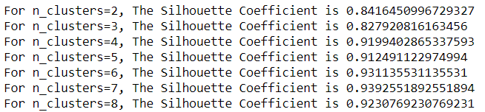
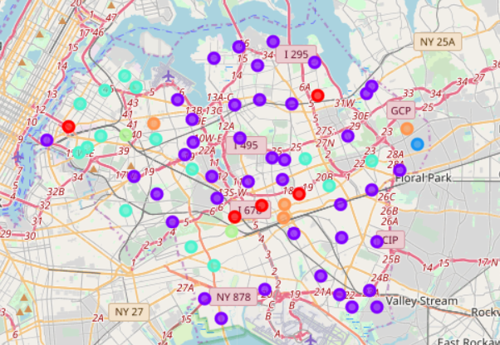
K-Means Clustering
One hot encoding used to assign low bit values to all but one.
Then the silhouette score method is applied to find the optimal number of clusters (n_clusters) for K-means clustering. This gives us an optimal value of around 6 clusters.
Using this value we carry on with K-means clustering and find that cluster1 (cluster label) has the lowest total sum, thus signifying that it represents the relatively unsaturated neighbourhoods.
Cluster1 is represented in the adjacent map by the darker blue circles.

Slide 15
Results

Slide 16
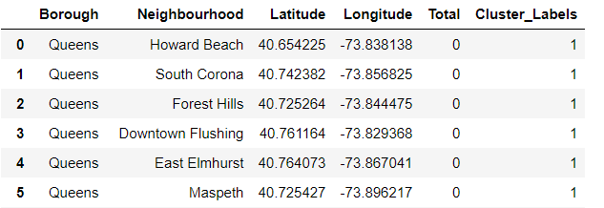
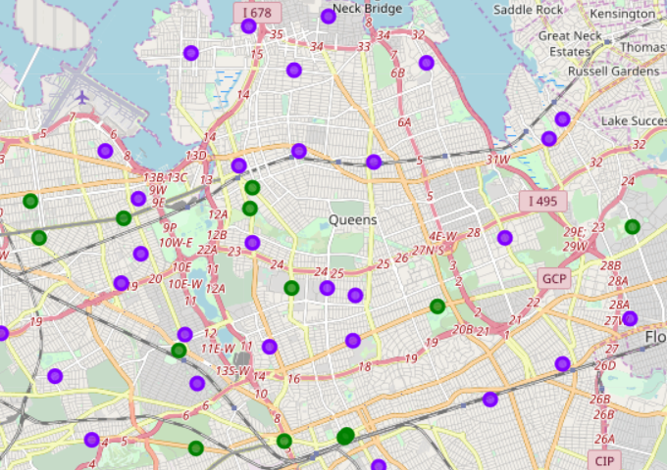
Final result and discussion
Separate dataframe constructed for Cluster1 values, containing unsaturated clusters.
On superimposing the farmers markets markers onto the map with unsaturated clusters, we can easily see the distance and convenience factor for each cluster. The clusters are shown in blue with the farmers markets overlaid in green.
Bronx, Queens and Staten Island contain some mildly unsaturated markets, whereas the rest are completely saturated.

Slide 17
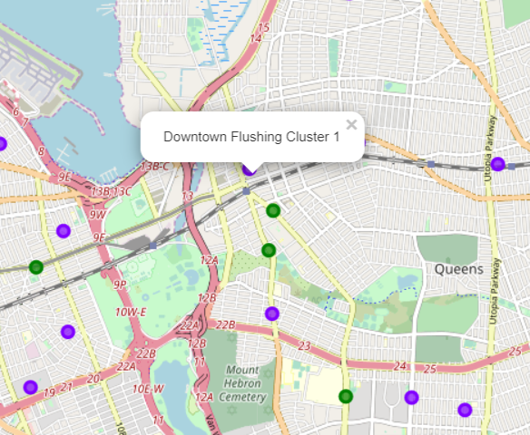
Conclusion
Queens was picked as this borough consists of the highest % of Indian-Americans, highest number of Indians/sq.mile and the food of choice in most neighbourhoods is Indian.
Even though Manhattan is a faster moving market, with a large number of Indian-Americans, it’s a very competitive space.
XYZ feels the restaurant will benefit from first opening a branch in Queens, with the option of branching out to Manhattan/Brooklyn in the near future.
XYZ carefully analyses the cluster selection and quality & distance to farmer markets, and decides Chef QWERTY should open his first restaurant in Downtown Flushing, Queens.

Slide 18
Thank you

